Slide 1
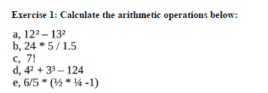
Labwork 2 - Polynomial
Too easy!
Give me the results

Slide 2
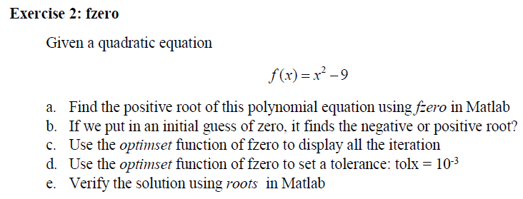
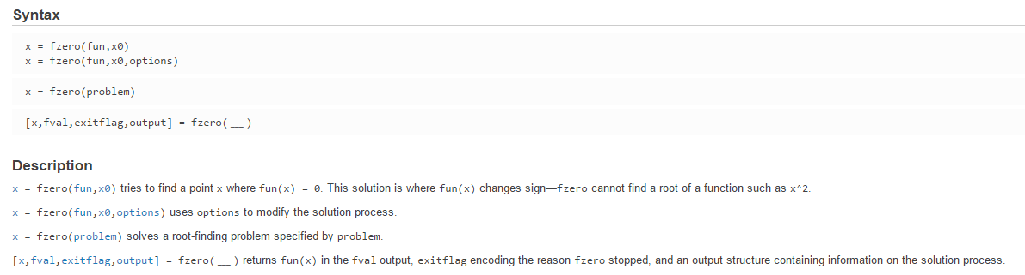
Labwork 2 - Polynomial
f = @(x) x^2 - 9;
a)
x0 = [0 4]; How to find negative root?
x = fzero(f,x0)
b)
x0 = 0;
x = fzero(f,x0)
c)
x0 = 0;
options = optimset('display','iter'); % show iterations
x = fzero(f,x0,options)
d)
x0 = 0;
options = optimset ('tolx', 1e-3);
x = fzero(f,x0,options)
e)
p = [1 0 -9]; What does this mean?
x = roots(p)
Hint: help fzero

Slide 3

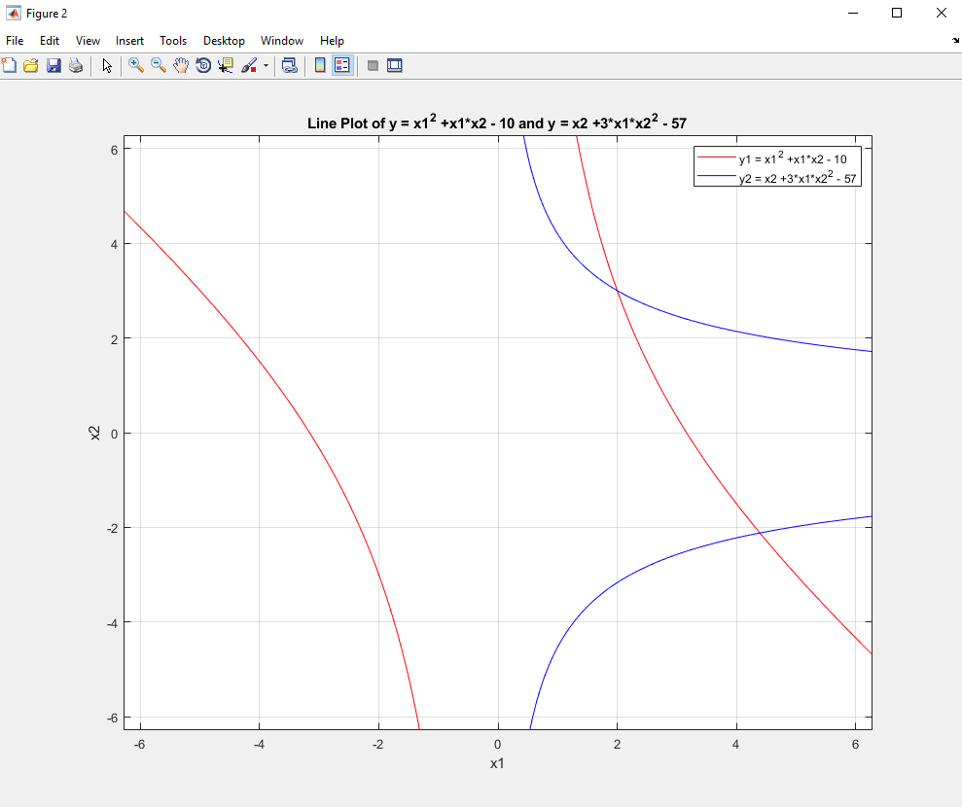
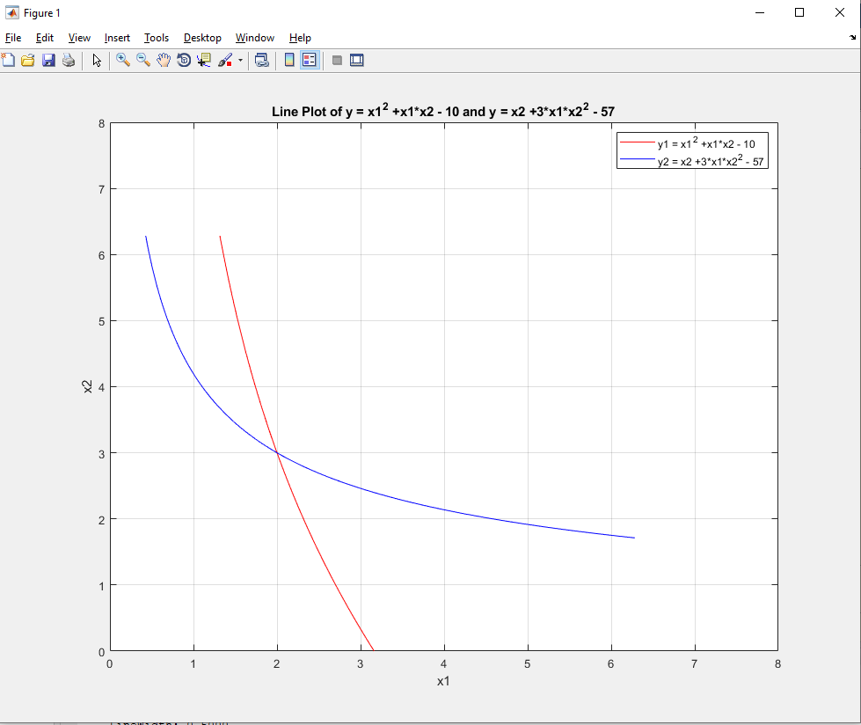
Labwork 2 – Non linear system (a)
f1 = @(x1, x2) x1^2 +x1*x2 - 10;
f2 = @(x1, x2) x2 +3*x1*x2^2 - 57;
Use the graph to derive good guesses using ezplot in Matlab
Hint: help ezplot
How to do this??

Slide 4
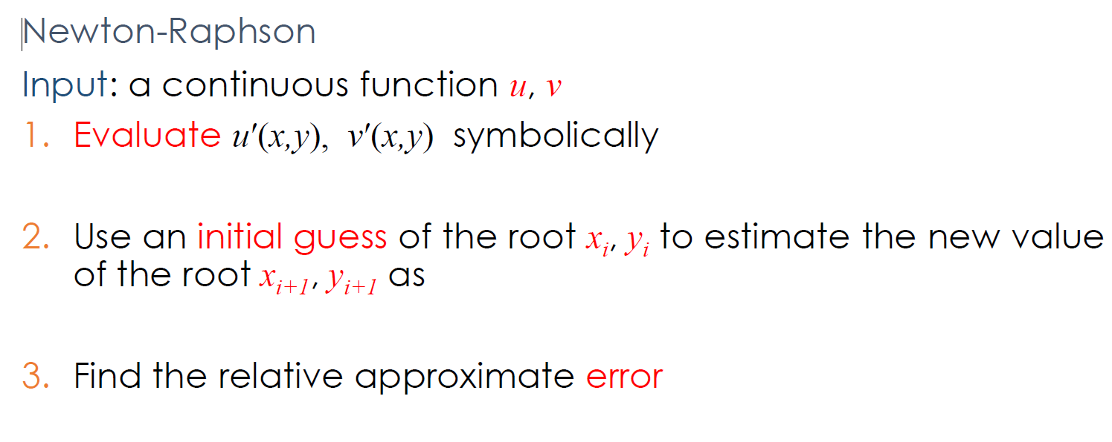
Labwork 2 – Non linear system (b)
Solve these equations using Newton-Raphson method

Slide 5
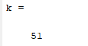


Labwork 2 – Non linear system (b)
x=[1 1]';
N = 50;
for k=1:N
F=[ x(1)*x(1)+ x(1)*x(2) - 10 ; x(2) + 3*x(1)*x(2)*x(2)-57];
A=[2*x(1)+x(2), x(1) ;
3*x(2).^2 , 1 + 6*x(1).*x(2)];
dx=A\F;
x=x-dx;
k=k+1;
end
k
x'
F'
Understand what are x, N, F, A, dx

Slide 6
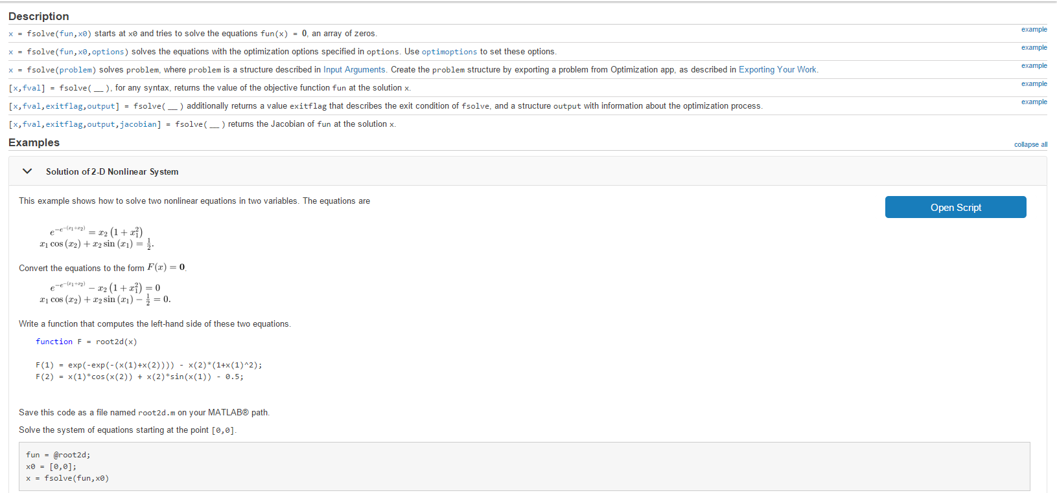
Labwork 2 – Non linear system (c)
function F = root2d(x)
F(1) = x(1)^2 + x(1)*x(2) - 10;
F(2) = x(2) +3*x(1)*x(2)^2 - 57;
end
Hint: help fsolve to find the solution

Slide 7

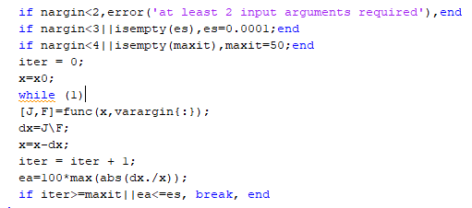

Labwork 2 – Non linear system (d)
Step 1: Define the root2(x) function
What are F and J?
Step 2: Create newtmult function
Understand the code
Step 3: Define x0, es, maxit
Then, call newtmult function to calculate the roots

Slide 8
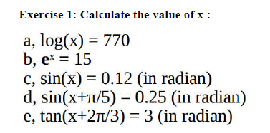
Labwork 2 – Common
% Log(x) = 0.77
x0 = 2;
func = @(x) log(x) - 0.77;
x = fzero(func, x0)
% Exp(x)
x0 = 0;
func = @(x) exp(x) - 15;
x = fzero(func,x0);
% Sin(x)
x0 = 0.2;
func = @(x) sin(x) - 0.12;
x = fzero(func,x0);
% Sin(x + pi/5)
x0 = 0.2;
func = @(x) sin(x + pi/5) - 0.25;
x = fzero(func,x0);
% Tan(x + 2*pi/5)
x0 = 0.5;
func = @(x) tan(x + 2*pi/3) - 1.5;
x = fzero(func,x0);
0.77

Slide 9
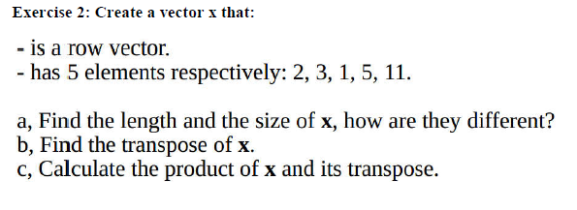
Labwork 2 – Common
x = [ 2 3 1 5 11]; OR x = [2, 3, 1, 5, 11]; OR x = [2; 3; 1; 5; 11];
a) Hint: use length() and size()
b) Do you remember how to get transposed vector?
c) try x*x’ AND x.*x’ => find the difference?

